Slide 1
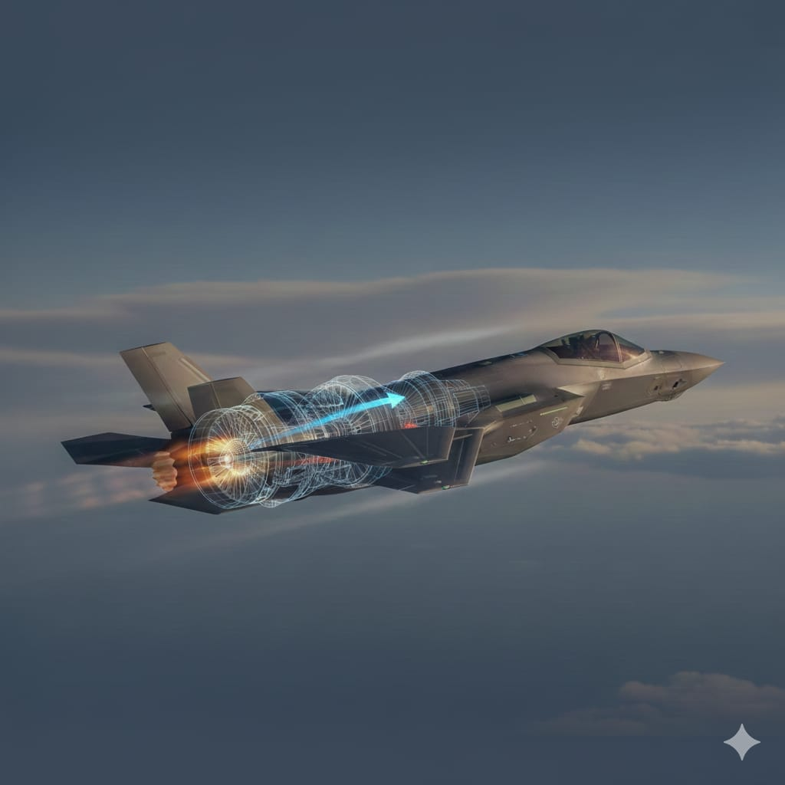



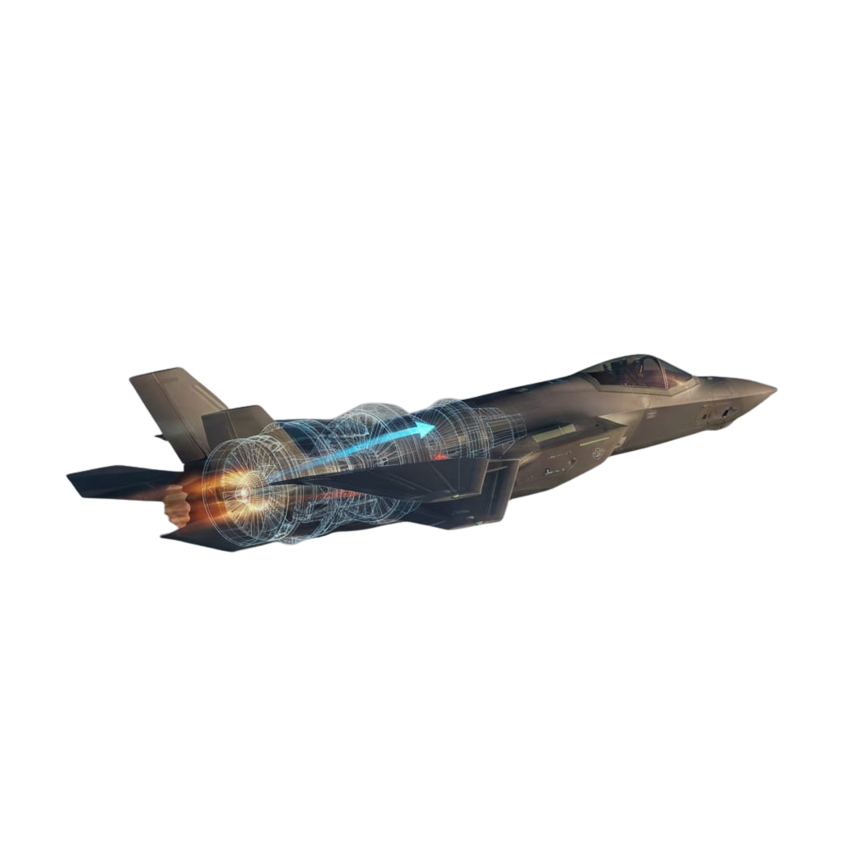
th
13 International Conference on Transformations in Engineering Education
(8th-10th Jan 2026) | EduAIThon 2026 @IASF | GITAM Deemed to be University, Bengaluru Campus, Karnataka
PROPULSION SYSTEM
Team details :
Faculty Coordinator :
Mr. B. Manideep
Assistant Professor, MLRIT
K. Shrilekha - 3rd year – CSD
M. Madhu Charan - 3rd year – IT
G. Kishan - 2nd year - AERO
MLR Institute Of Technology

Slide 2
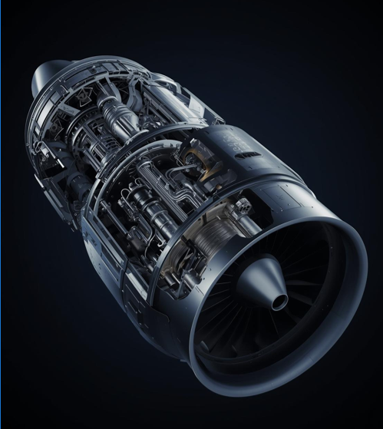

INTRODUCTION
Propulsion is the science behind movement in engines.
It is often difficult for beginners to understand.
Traditional learning focuses on theory and formulas.
This project aims to make propulsion simple and visual.
PropulseAI helps users learn by seeing and interacting.
Generated using AI
MLR Institute Of Technology
02

Slide 3





EMPATHY MAP
Users Think
Users Do
“Jet engines look complex”
“I can’t visualize what happens inside”
Memorize theory without understanding
Avoid deep analysis
Users Feel
Confused by internal processes
Intimidated by formulas
Generated using AI
MLR Institute Of Technology
03

Slide 4

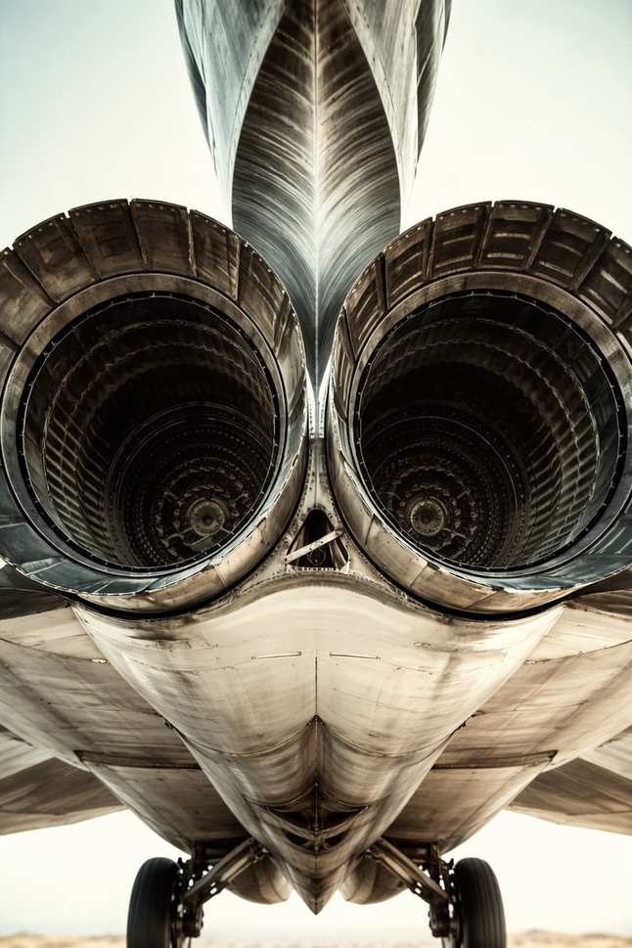
PROBLEM STATEMENT
Students learning jet propulsion struggle to develop intuitive understanding because critical engine processes are hidden and teaching methods emphasize equations over visualization. As a result, learners find it diffcult to connect theoretical concepts with real engine behavior, leading to confusion, weak conceptual clarity, and low confidence in understanding propulsion systems.
Generated using AI
MLR Institute Of Technology
04

Slide 5






EXISTING METHODOLOGIES
Method 1
Method 2
Method 3
Jet propulsion is traditionally taught through classroom lectures that primarily focus on theoretical concepts, definitions, and verbal explanations of propulsion principles, with limited visual representation of actual engine processes.
Textbooks are commonly used to explain engine components and working mechanisms through static diagrams and written descriptions, which often fail to show real-time airflow, combustion, and exhaust behavior.
Mathematical equations and numerical problem-solving methods are emphasized to analyze thrust, pressure, temperature, and engine performance, making learning heavily calculation-oriented rather than concept-driven.
Title
Title
Title
Content
content
Content
MLR Institute Of Technology
05

Slide 6

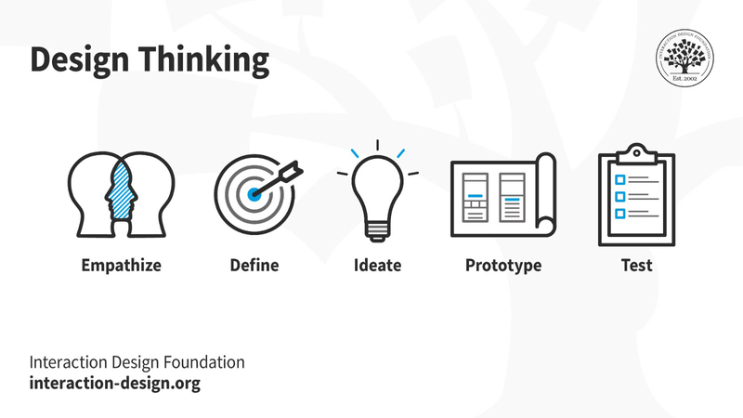
DESIGN THINKING JOURNEY
EMPATHIZE
IDEATE
Understanding that beginners struggle to visualize and grasp complex propulsion concepts.
Create an AI-powered platform with engine visualizations, guided learning, and experimentation.
DEFINE
The problem is the lack of interactive, visual, and beginner-friendly propulsion learning tools.
PROTOTYPE
Develop an interactive jet engine model with step-by-step AI explanations and simulations.
TEST
Evaluate learning effectiveness through user feedback, quizzes, and performance improvement.
MLR Institute Of Technology
06

Slide 7
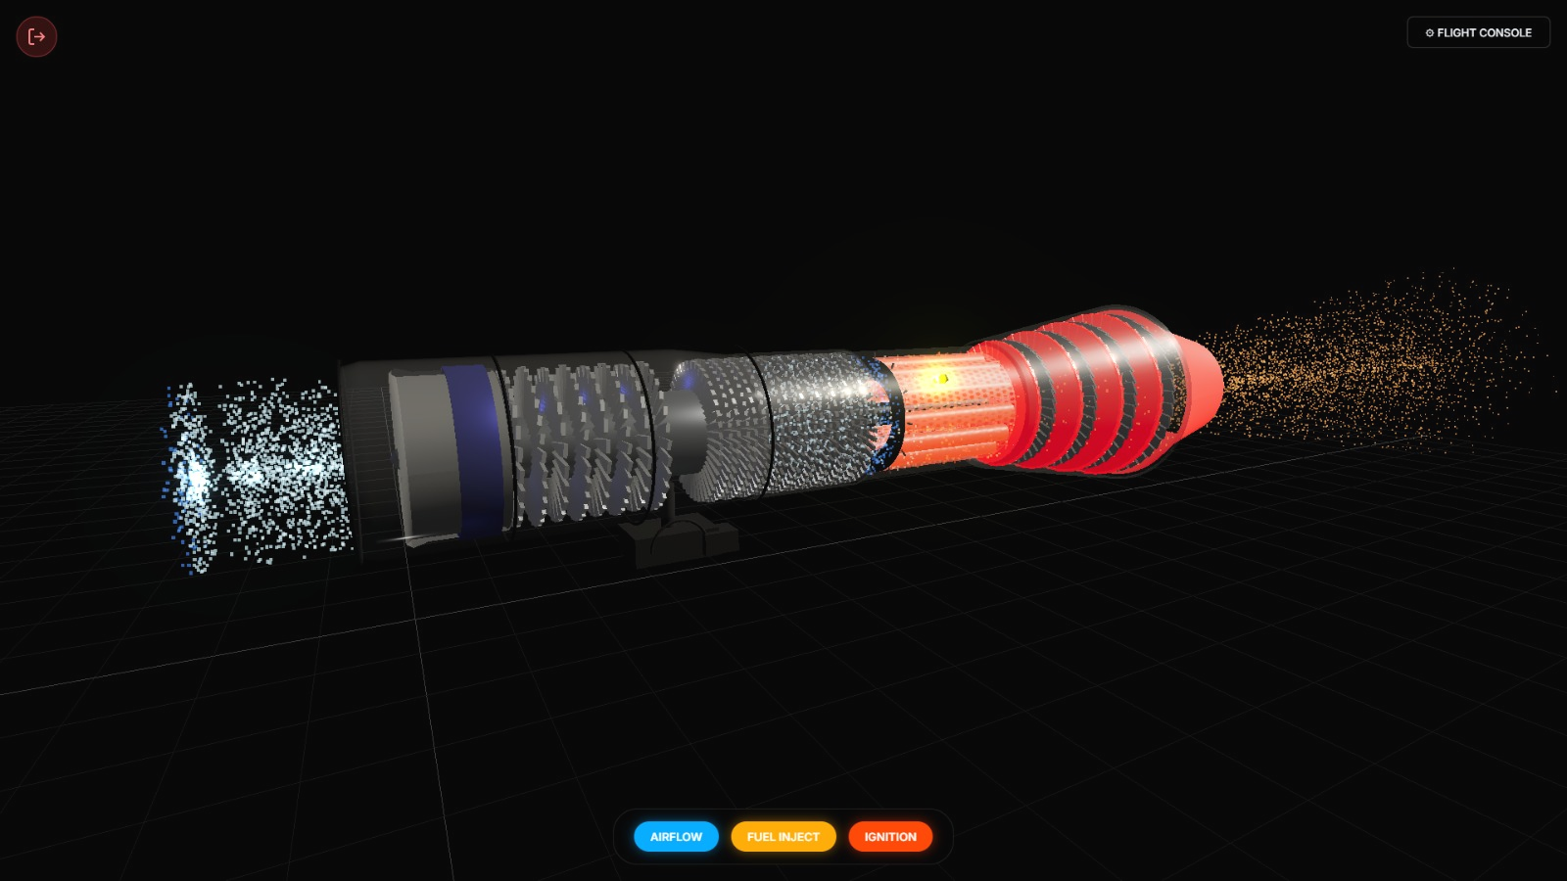
PROPOSED SOLUTION
To improve understanding, propulsion concepts should be explained using real engine images and visual representations. Learning should focus on airflow stages, combustion, and exhaust flow rather than only equations. By connecting theory with real aircraft performance and simplifying explanations, students can develop stronger conceptual clarity and confidence.
MLR Institute Of Technology
07

Slide 8


CORE FEATURES
CAPABILITIES
AI-guided, step-by-step engine basics for beginners.
AI mentor explains propulsion concepts in an
easy way.
Interactive 3D views showing airflow, heat, and components.
3D engine models visualize airflow and heat flow.
Real-time engine tuning with instant performance feedback.
Interactive engine sandbox enables hands-on
learning.
Mission-based, feedback-driven learning from basics to advanced.
Guided learning path develops skills gradually.
MLR Institute Of Technology
08
Notes:
8

Slide 9

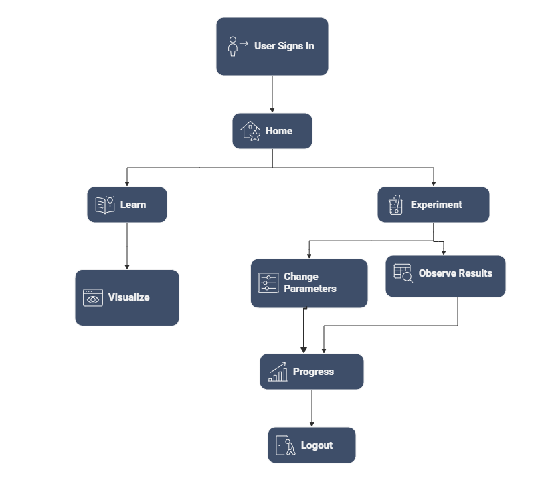
USER INTERACTION FLOW
PropulseAI – User Interaction Flow
Login – User signs in
Home – Choose Learn or Experiment
Learn – Basics with visuals
Visualize – See engine working
AI Check – Quick concept question
Experiment – Change parameters, observe results
AI Guide – Instant help & feedback
Progress – Track learning level
Logout – End session safely
09

Slide 10
IMPACTS
SIGNIFICANCE
Bridges the gap between theory and application.
Makes aerospace education easy for newcomers.
Encourages interest and sustained study.
Prepares students for advanced engineering.
Improves conceptual clarity and learner confidence
Builds a strong foundation for advanced aerospace studies.
Prepares students for advanced concepts.
10

Slide 11


CONCLUSION
Using real engine images and visual airflow stages—compression, combustion, and exhaust—alongside theory helps students better visualize thrust generation. Connecting equations to actual aircraft performance simplifies complex propulsion concepts and improves understanding, clarity, and confidence.
“PropulseAI – shaping the future of propulsion learning"
11

Slide 12

THANK YOU
12

